Slide 1
GPS Tags for Bat Conservation
Presented by Josie Hoppenworth¹
¹ Human-Wildlife Interactions Lab at the University of Illinois Urbana-Champaign
Department of Natural Resources and Environmental Sciences
Photo by Merlin Tuttle
Notes:
Good afternoon everyone! My name is Josie Hoppenworth and I’m a master’s student in the department of natural resources and environmental sciences. I conduct research in the human-wildlife interactions lab where I study bats of the Eastern United States. For bat biologists, tracking the movements of bats is critical to our understanding of how different species use the landscape. With this in mind, the project I propose is the creation of a miniature GPS tag that my lab and others in our field can use to further the conservation of these mammals.

Slide 2
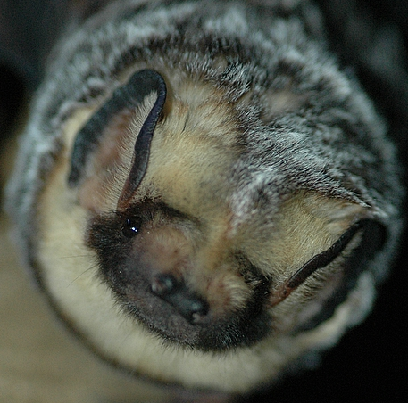
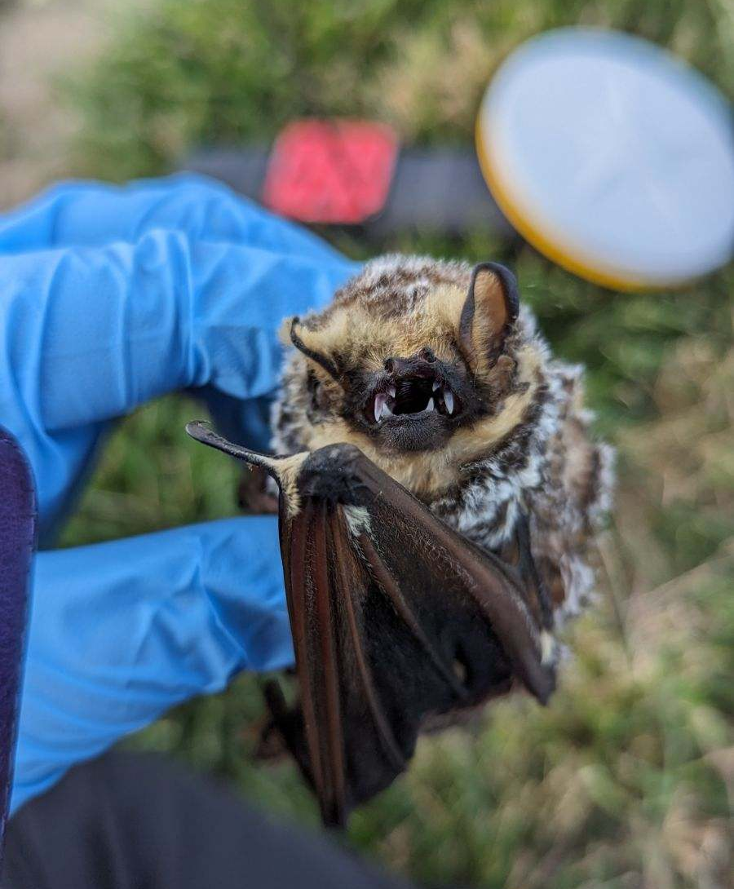
Technological advancement is needed to improve bat conservation efforts.
Bats provide pest control, pollination, and seed dispersal
33% of bat species in the U.S. are a conservation concern
Population declines caused by… white nose syndrome, habitat destruction, & wind turbines
>400,000 hoary bats killed by wind turbines annually (TWS 2023)
VHF tags ($185/tag) and untraceable GPS tags ($550/tag)
Hoary bat found dead under a wind turbine
VHF Tag
Photos by Joy O’Keefe, Rebecca Moore, and Holohil, Inc.
Notes:
The United States is home to 45 species of bats. These bats provide a number of invaluable services for humans which include pest control, pollination, and seed dispersal. Insectivorous bats can consume up to their weight in bugs every night and their diets include bothersome insects like mosquitoes. Despite their benefits, one third of bats in the United States are listed as either federally endangered, threatened, or are currently being considered for federal listing. Population declines across species has been attributed to white nose syndrome, habitat destruction, and wind turbines.
The hoary bat, which is pictured on the left, is a migratory species that can travel more than 1000 miles from it’s summer habitat to winter hibernacula. Unfortunately, recent studies estimate that more than 400,000 hoary bats are killed every year by wind turbines during this journey. Scattered throughout their migratory path, wind turbines decimate these bats in two main ways - the first is through direct collisions and the second is through tissue damage caused by pressure changes. Because little is known about the flight path of the hoary bat, little can be done to protect them. To monitor the movements of bats like this, VHF tags and untraceable GPS tags are the only devices currently available and both have their downsides.
VHF tags are radio transmitters which emit a very high frequency. Bat biologists deploy these tags on a variety of species by glueing them on their backs. They then use a receiver and antenna to manually track the location of the individual. By pointing the antenna in different directions, the receiver picks up beeps from the VHF tag. The person tracking follows the direction of the beeps until they can triangulate a position. This is a labor intensive process and works best when the bat is stationary.
Untraceable GPS tags are another technology for tracking the movements of bats. They are attached in the same manner as VHF tags and store positional data in the device. While there are a few GPS devices small enough for a bat to carry, they aren’t easily retrieved. The GPS tags currently on the market cannot be tracked. The retrieval of data is therefore dependent on recapturing tagged individuals before the tag falls off, which is not common.

Slide 3
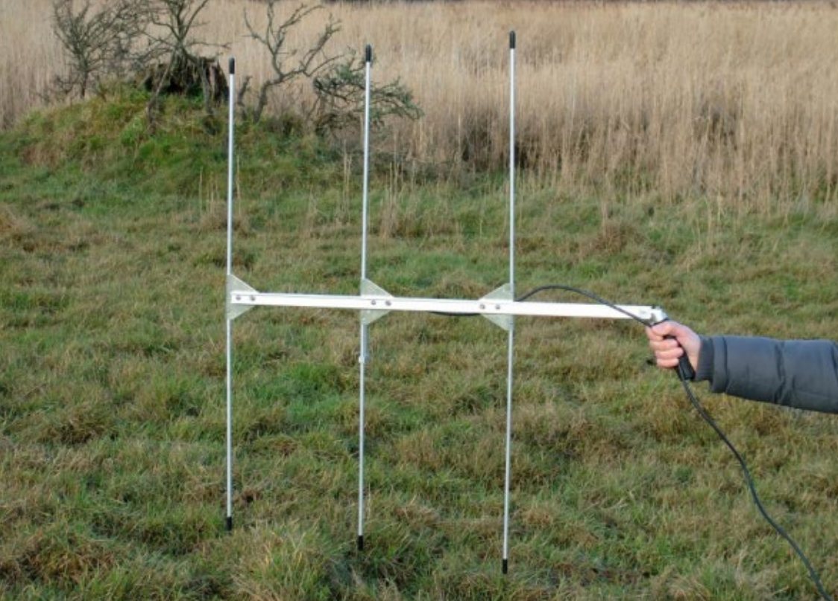
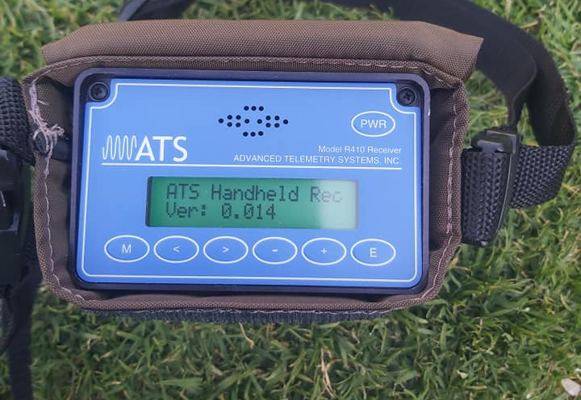
How can a GPS tag and VHF tag be combined?
Challenge: Create a GPS tag that emits a VHF
Goal weight - less than 1.5 grams
Dimensions approx. 21 x 13 x 5 mm
Programmable to collect data at specific times
Collect a fix every 5-10 mins over 6 hour periods
GPS battery life of 3 days, VHF life of 7-14 days
VHF signal of 1km
Rechargeable
Temperature sensor (if possible)
Other Considerations:
Low-cost and can be recreated
3-element Yagi antenna
Receiver
Tag
Photos by Reed Crawford and Ecological Logistics
Notes:
Therefore, our proposed project is a tag which combines the qualities of both a GPS and VHF tag for practical use in bat research. The product we envision is a hybrid device that collects and stores positional data while also emitting a very high frequency for easy tracking and data retrieval. The tag will be attached to the back of the bat using glue until eventually the tag loosens and falls off. Using our antenna and receiver, we will then track the fallen tag using the VHF signal and retrieve the data recorded by the GPS.
To be used for bat research, the specifications of this device are as follows…
The finished product has a goal weight of being less than 1.5 grams. This weight is selected based on best-practices, and would allow us to attach the device to some of the larger bat species in the United States.
Because the tag will be glued to the back of the bat, the dimensions of the product are also important. To maintain the bats maneuverability, it should be approximately 21 x 13 x 5 mm in size with 5 mm representing the thickness of the tag.
The device should be programmable to collect data at specific times. Since bats are nocturnal, there is no need for the device to be recording positional data during the day.
When fully operating, the goal is then for the tag to collect a positional fix every 5-10 minutes. It should be able to do this for a six hour period every day for 3 days.
While the GPS life should last 3 days, the VHF will hopefully emit a signal for longer than that. Because of the amount of time it takes for tags to fall off, the VHF portion of the tag should emit a signal that can travel 1 km for at least 7-14 days. This gives us time to track the tag once it has dislodged from the bat.
The last requirement is that the tag is rechargeable and able to be reused after recovery. Because we must retrieve the tag to download data, being able to refurbish it would help decrease costs over time.
If possible, a temperature sensor would be a useful addition to this device.
Some important considerations for this design are that the final product should be low-cost and able to be recreated. Using a design by a group this class, my hope is that my lab and other biologists can implement the created device to better our understanding of bat species for future conservation efforts.

